Slide 1



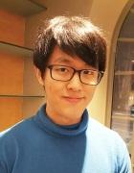
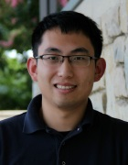
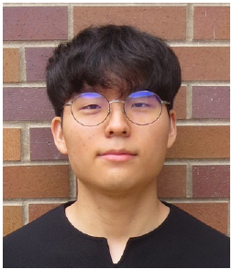
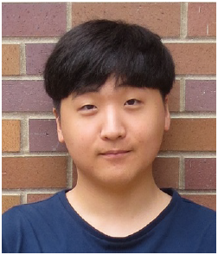
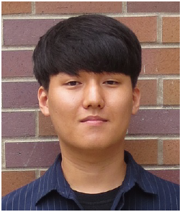
Security Implications of Compressed Neural Networks for Self-Driving Cars
Prof. Sang Woo Jun
Prof. Qi Alfred Chen
Donghyeon Choi
Woolim Cho
Donghak Park
Notes:
Hello Today we will introduce about Security implications of compressed neural networks for self-driving cars.
My team is under the guidance of Professor Sang Woo Jun and Professor Qi Alfred Chen. and consist of 3 fellowers 조우림, 최동현, 박동학.
Our team wasn’t originally on the project list, but it was newly formed at prof’s suggestion.

Slide 2
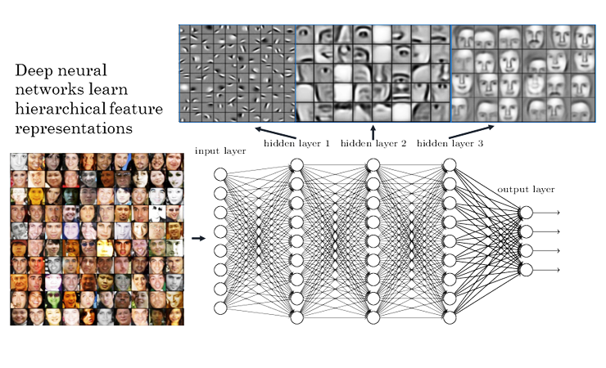
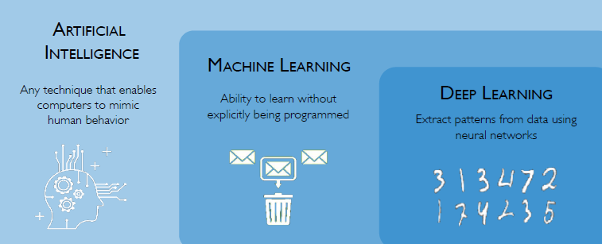
Introduction
Notes:
Then Let’s talk about Nerual Network
As you know, there has been a growing interest in artificial neural networks for last few years.
And Deep running is critical technology for machine learning and artificial intelligence.
As you can see in the picture above, neural networks allow input data to move multiple layers and gradually recognize it and lead to output.

Slide 3
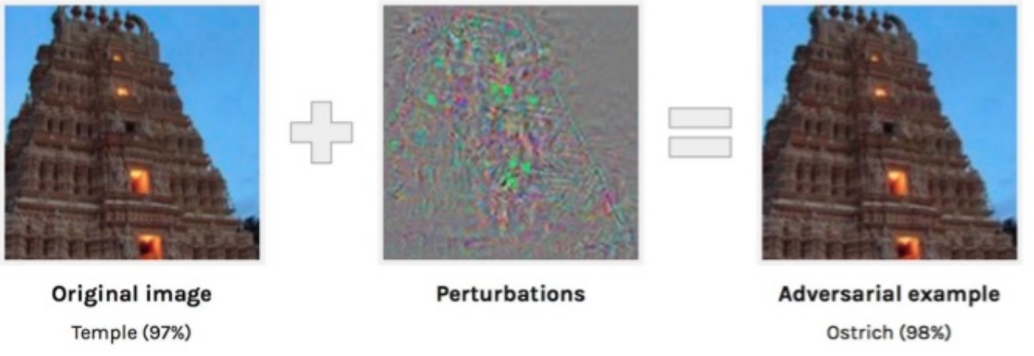
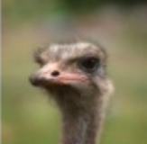
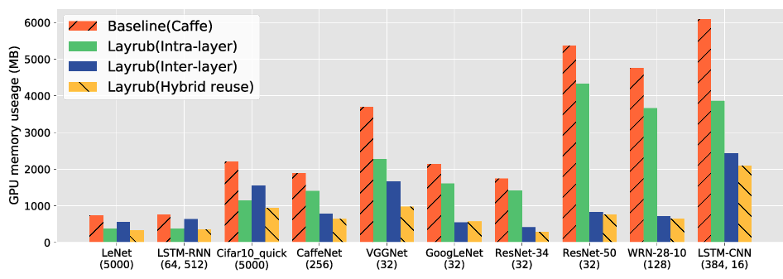
Problems
?
Notes:
But Neural Network have some problems,
and We're focusing on two issues
The first is that they're vulnerable to Adversarial attack.
In the picture above, if you add a small noise to the temple picture. it is input image,
And as a output image/ model recognize it as a ostrich
The second is that the uncompressed neural network model has a very large capacity, which can be limited in practical use.

Slide 4
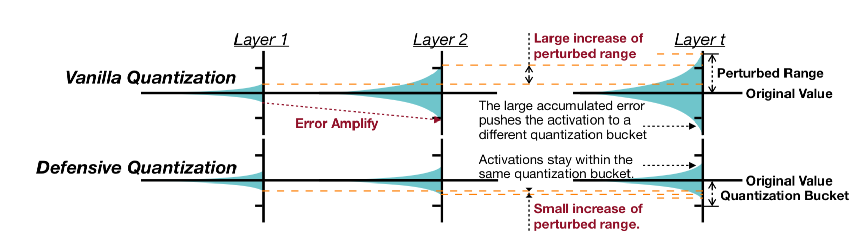

Progress
Lipschitz Regularizer
Adversarial Training
Quantization
1.2384 => 1.25 (4byte to 4bit)
(Defensive Quantization,Ji Lin et al, 2019)

Slide 5
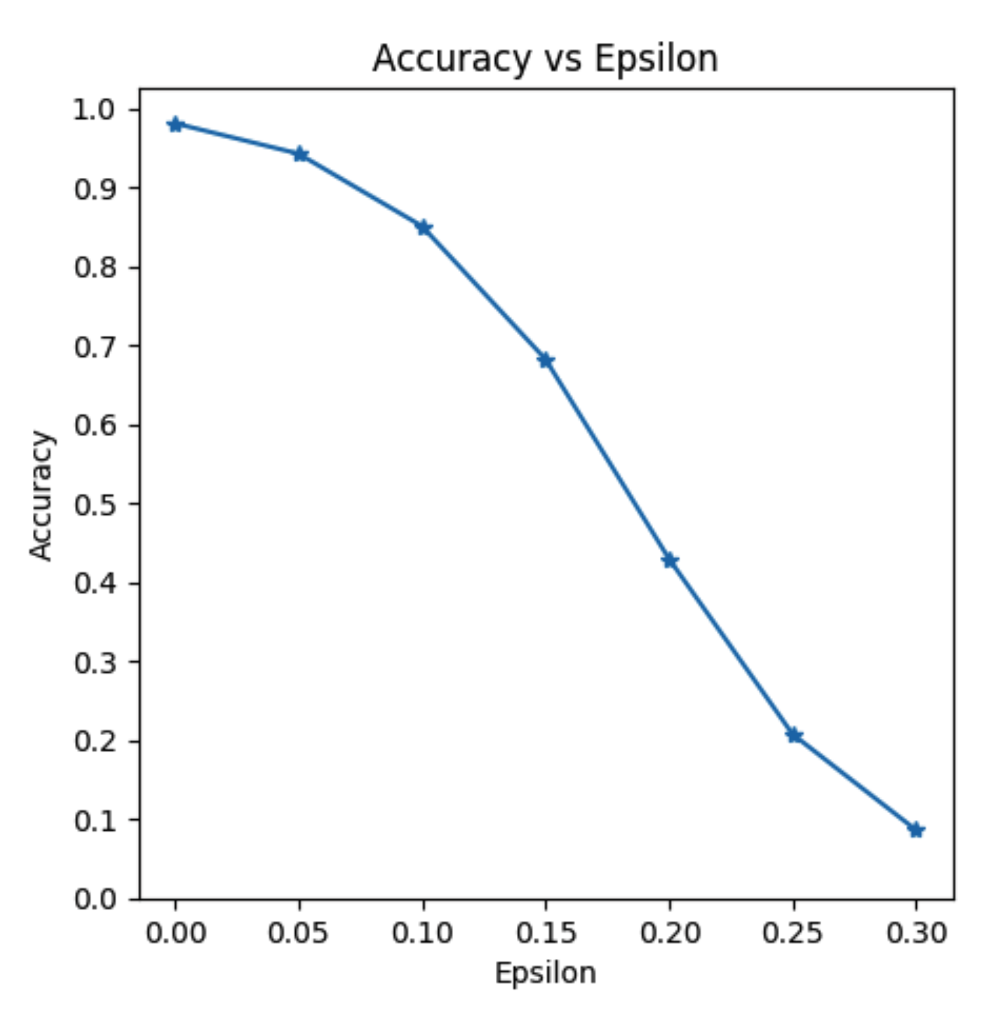
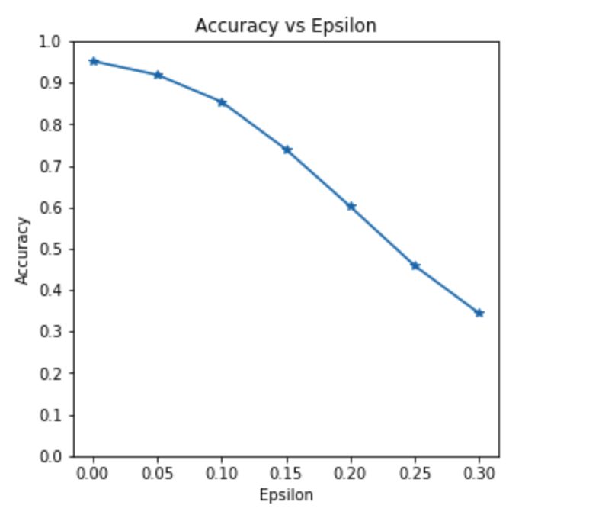
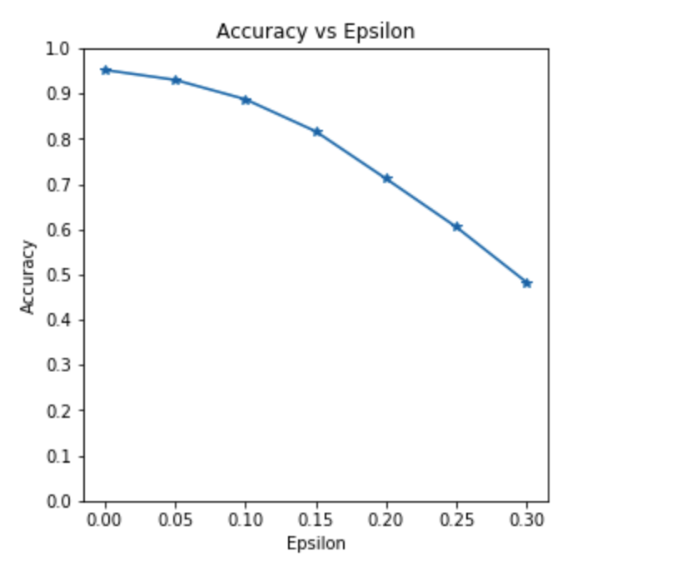
Progress
LeNet, MNIST
Original
Lipschitz Regularizer
Adversarial R+FGSM Training
with Lipschitz Regularizer

Slide 6
Future work
Try various deep learning models
test set (original images or adversarial images)
learning adversarial images
Defensive Quantization
Pruning
other compression technology (zfp ..)
Notes:
So our team will combine several deep learning compression Technology to carry out various experiments using several paper.
and our team's goal is to produce meaningful results through these experiments.
this is variables for the experiment.
first, we will use resnet and vgg model that is introduced in the paper.
and We will use original images and adversarial images to make sure the model can defend against attack.
In addition, We will use adversarial images as trainning data or experiment with Defensive Quantification or Pruning or other compression technology.
So our team's first goal is to find an effective combination of deep learning compression technology through these experiments.

Slide 7
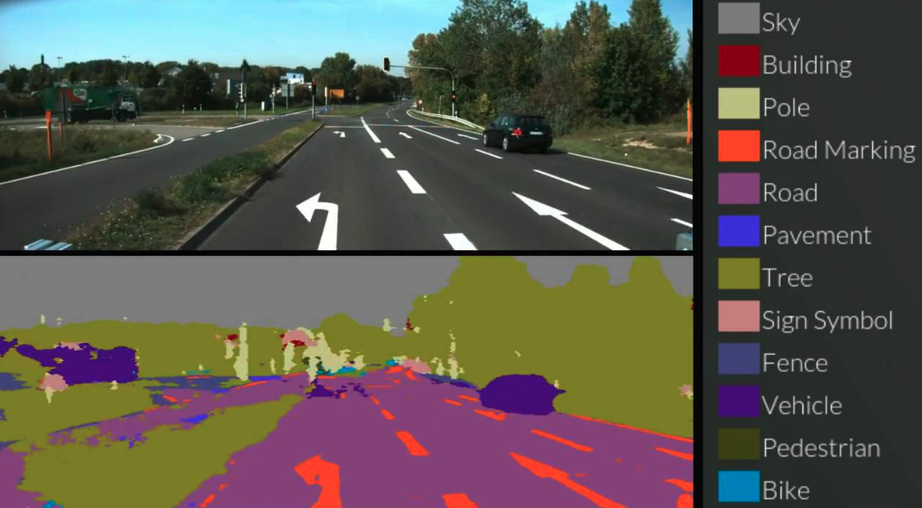
Goal
Notes:
finally our team's second goal is to apply technology of compression in self-driving car.
So our team will improve the performance of self-driving car.
I would like to finish by thanking you all for your attention.

